Slide 1


Chameleon
Can a single pair of shoes change your life?

Slide 2
We are Dream Killers…....
Savani De Silva
Vanodhya Oshadhi
Sanduni Fernando
Chanodya Welikala
Sanushka Amani
Lakshana Vadivalagan

Slide 3
Content
Problems
Solutions
Segmentation
Promotion
Pricing strategy

Slide 4
Problems
Need many pairs of shoes for different occasions.
Huge amounts of money spent on shoes.
Requires huge space to store many pairs.
High shopping pressure.
Inability of choosing the best matching shoes.

Slide 5
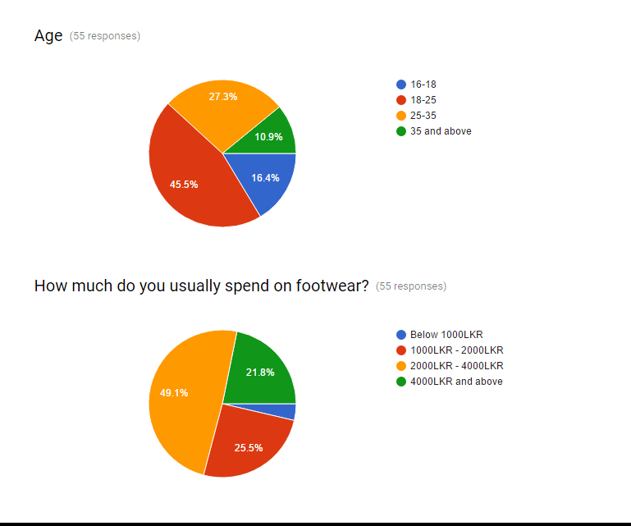
The Research we conducted

Slide 6
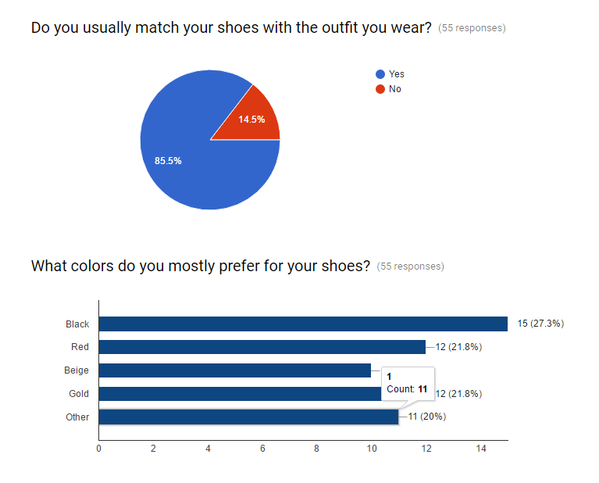

Slide 7
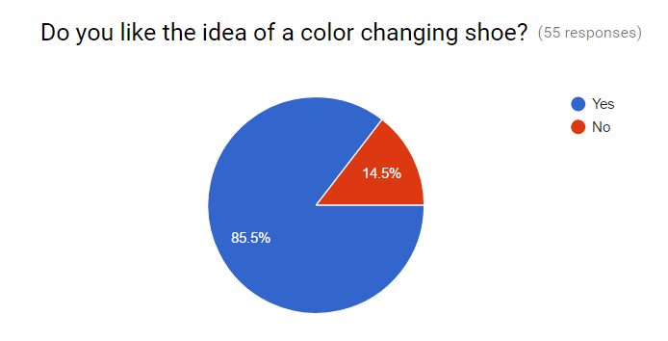

Slide 8
Solutions
Colour changeable shoes
One pair of shoe for many occasions
Save money
Needs less space
Ease of changing colours
Customizable

Slide 9
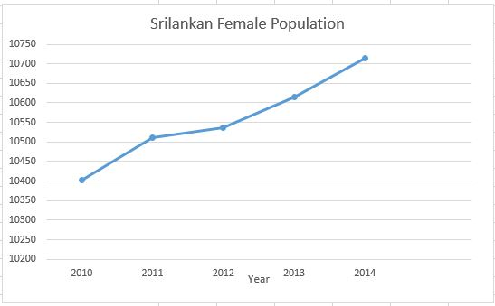
Target Market
Women above 16 years old
Fashion conscious ladies
(Central Bank of Sri Lanka, 2015)

Slide 10
Promotion
New media
Advertising
Personal selling
Sales promotions
Post to deal sites

Slide 11
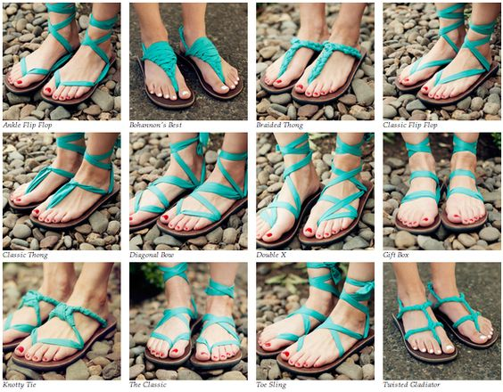
SWOT Analysis
Strength One pair of shoes for many occasions. Custom made designs are available. No shopping pressure. No need of spending money on different shoes | Weakness Less brand reputation. Lack of manufacturers. Less funding. Shoe technics aren’t understood by the targeted audience.
Opportunities New fashion trends are emerging rapidly. Percentage of female population is high. Chameleon could also developed globally. Less competition. | Threats Customers reaction on pricing policy. Can easily imitate the idea. Lack of manufacturers. Tax rates are increasing.

Slide 12
Market Segmentation
Geographic
Immediate geographic target is the Colombo city women
Demographics
Age-16 to 40.
65% of customers are working women.
Working women monthly income will RS40000 to RS150000.
35% of customers are teenagers
Mostly there are income base on their parents salary
Behavioural factors
Fashion conscious
Aware of different fashion trends

Slide 13
Key to success
Well trained employees.
Distribution in stylish showrooms.
Different selections in colour changing shoes.
Good customer service.

Slide 14
WORLD IS CHANGING
Join the trend
and
Change with the pace….
Pre order Now!
E- mail address – oreal@gmail.com

